Slide 1
FORECASTING Air Passenger Data GROUP PROJECT DSCI 4510
Magloire, Dylan, Chelsea
DSCI 4510

Slide 2
01
Data Source and Characteristics
AGENDA
02
Naïve Model Benchmarking
03
Forecasting Models
04
The Best Forecasting Model
05
Manager Forecast

Slide 3
Part 1 – Data Source and Characteristics
Data Source
The Air passenger datasets, sourced from Kaggle, contains monthly totals of international and domestics airlines passengers from January to December. This dataset is widely used for time series analysis and forecasting
Data Characteristics:
Type: Time series data on air passenger numbers
Variables: Monthly passenger counts, year, seasonality factors
Time Frame: Data covers from 2013-2024
Background Story:
The air travel industry is crucial for economic growth and understanding passenger trends helps in operational planning

Slide 4
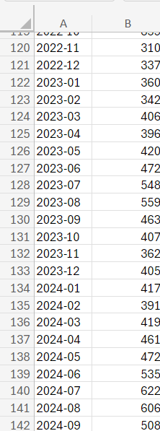
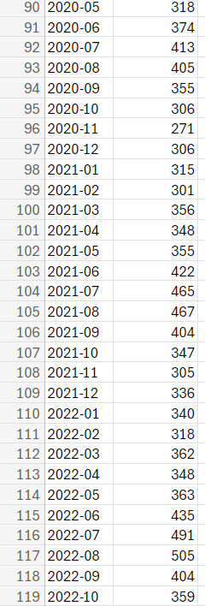
About the Data

Slide 5
Naïve Model
Monthly Predictions:
October 2024: 508 passengers
November 2024: 508 passengers
December 2024: 508 passengers
Found using previous month’s actual data as next month’s forecast
Serves as comparison for other models
There are likely better models available

Slide 6
Naïve Model
RMSE: 33.11
MSE: 1096.38
MAE: 25.49
MAPE: 8.94
R-Squared: 0.92

Slide 7
Winter’s Multiplicative Model
Monthly Predictions
October 2024: 443
November 2024: 388
December 2024: 428
Takes Seasonality into account
Useful for forecasting time series
Changes with the data to remain adaptable

Slide 8
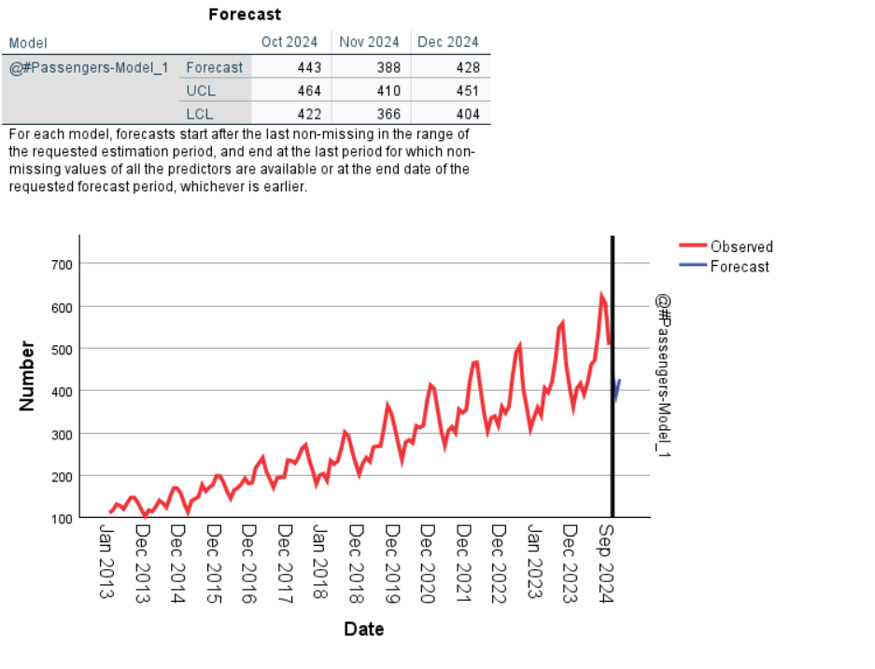
Winter’s Multiplicative Model
RMSE: 10.7
MAE: 7.99
MAPE: 3.093
MSE: 114.49
R-Squared: 0.99

Slide 9
Moving Averages
Average of previous periods is used as forecast for next period
We did 3-month, 6-month, and 9-month
Most useful with little seasonality

Slide 10
3-Month Moving Average
Monthly Predictions
October 2024: 578.67
November 2024: 578.67
December 2024: 578.67
Uses last 3 months to predict the next month
Our model got less reliable over time
Less reliable than naïve model

Slide 11
3-Month Moving Average
RMSE: 46.42
MSE: 2154.91
R-Squared: 0.85
MAE: 34.95
MAPE: 11.96

Slide 12
6-Month Moving Average
Uses average of previous 6 months to forecast the next month
Less reliable than the 3-month average
Lacks seasonality and fails to adjust for trends
Monthly Predictions:
October 2024: 534
November 2024: 534
December 2024: 534

Slide 13
6-Month Moving Average
RMSE: 54.50
MSE: 2970.615
MAE: 42.14
MAPE: 14.15
R-Squared: 0.79

Slide 14
9-Month Moving Average
Uses average of previous 9 months to forecast the next month
Far less reliable than 3-month moving average; as the size of our moving average increases, so does the error
Not a good model to use when the data has high fluctuation
Monthly Predictions
October 2024: 492.33
November 2024: 492.33
December 2024: 492.33

Slide 15
9-Month Moving Average
RMSE: 55.97
MSE: 3132.44
MAE: 39.75
MAPE: 13.18
R-Squared: 0.78

Slide 16
Holt’s Method
Monthly Predictions
October 2024: 511
November 2024: 513
December 2024: 516
Similar to Winters method but lacks seasonality
Good flexibility for changing data
Our group found it using SPSS

Slide 17
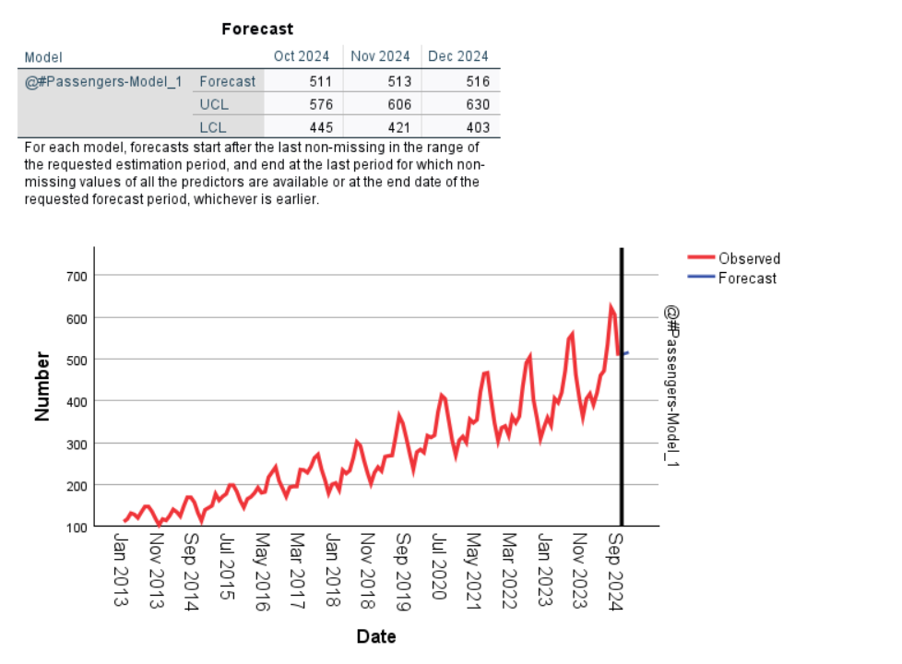
Holt’s Method
R-Squared: 0.92
RMSE: 33.11
MAE: 24.89
MAPE: 8.86
MSE: 1095.63

Slide 18
Part 5 - Recommendation for managers
We recommend using the Winters Multiplicative Method for forecasting future air passenger numbers, based on our comprehensive analysis.
This method consistently demonstrated the lowest MAPE, RMSE, MSE, MAE, and the highest R-Squared.
Our forecast for the next 3 months is as follows:
October 2024: 443
November 2024: 388
December 2024: 428

Slide 19
Thank you! Any Questions?

